Slide 1
Introduction to Computational and Algorithmic Thinking
Lecture 1 – Computational Thinking

Slide 2
Announcements
This lecture: Computational Thinking
Reading: Read Chapter 1 of Conery
Acknowledgement: These slides are extended version of slides prepared by Prof. Arthur Lee, Prof. Tony Mione for earlier CSE101 classes.

Slide 3
What is Computer Science
Computer science is all about using computers and computing technology to solve challenging, real-world problems in science, medicine, business and society (for us for now)
Computer science = computer programming ⬅ Not true
Computer programming is an important aspect of computer science
Computer programs often provide (parts of) the solutions to challenging technological problems
Computer science is also not:
computer literacy
computer maintenance/repair
a fast track to becoming a nerd

Slide 4
Are you a good fit for CS?
You are a good fit for computer science if:
You are naturally curious and inquisitive.
You feel compelled to solve problems and puzzles.
You have a creative spirit and like making things.
You think in a logical, step-by-step manner.
You approach issues from unconventional angles.
You are willing to evolve and learn new things every day.
You are self-driven and have enough grit to endure long periods of frustration.
You know how to search the web for answers.
List courtesy http://www.makeuseof.com/tag/what-is-computerscience

Slide 5
A modern computing problem
Electronic health records are becoming increasingly important as time goes on
Consider issues (technical + others) that arise providing a hw/sw system to medical professionals and others who need access to digital medical records:
What data will be stored? How? In what format?
How will the data be accessed and displayed?
Who will have access? How will the data be secured?
How will the data be backed up and preserved?
Answering these questions requires computational thinking

Slide 6
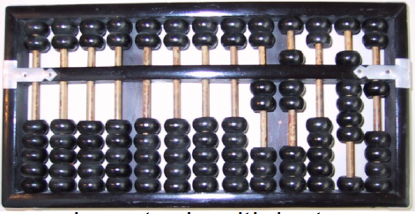
A quick history of computing
We think of computers as modern inventions
Computing devices
go back thousands of years
have many of the same basic features of digital computers
Abacus – an early device to record numeric values and do basic arithmetic (16th century B.C.)
https://www.youtube.com/watch?v=GF6nCmcQ5es
What does an abacus have to do with laptops, smartphones and tablet computers???

Slide 7
A quick history of computing
Modern computers borrow four important concepts from the abacus:
Storage
Data Representation
Calculation
User Interface
Storage:
an abacus only stores numbers, which are the most fundamental type of data in modern computing.
In a modern computer, all data – text, images, audio, video – is represented using binary numbers (1s and 0s)

Slide 8
A quick history of computing
Data Representation
the abacus represents numbers using beads on spindles.
Modern computers employ a variety of techniques for representing data on a variety of storage media
Magnetic
Optical
Electrical
Calculation
by moving beads on abacus’ spindles, user can perform addition, subtraction, multiplication, and division
Modern computers contain powerful central processing units that perform calculations at astonishing speeds
User Interface:
the beads and spindles on the abacus
Modern computers provide a wide variety of input and output devices for the user

Slide 9
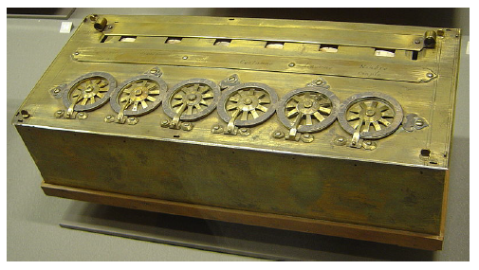
A quick history of computing
In the 17th century people began tinkering with physical devices that could do computations and calculations
Blaise Pascal
the French mathematician and philosopher
one of a few to design and build a physical calculator
Calculator could only do addition and subtraction
Input is given using dials
Output is read on small windows above each dial

Slide 10
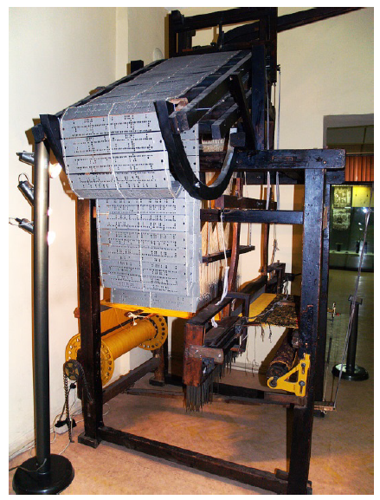
Programmable devices
Pascal’s calculator and other similar devices of that time were not programmable
One of the first programmable devices in history was a loom
Joseph Marie Jacquard’s loom (1804) could be programmed by feeding in a set of punched cards
This is not all that different from quitting a program that’s running on your computer and starting another one!
https://www.youtube.com/watch?v=MQzpLLhN0fY

Slide 11
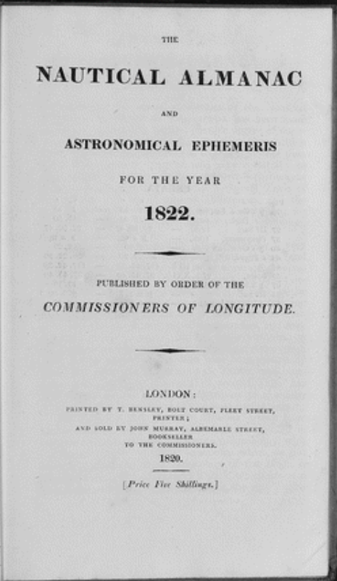
Rise of Analytical Engine
Summer of 1821 – Mathematician Charles Babbage and astronomer John Herschel were working on creating a book of mathematical tables.
Almanac contains tables denoting positions of the Moons, planets and stars – which are used by navigators to determine location at the sea.
Manual work caused a number of errors.
Babbage showed his frustration with the large number of errors by exclaiming, “I wish to God these calculations had been executed by steam!”
What made Babbage think steam engines could help him solve mathematical problems?

Slide 12
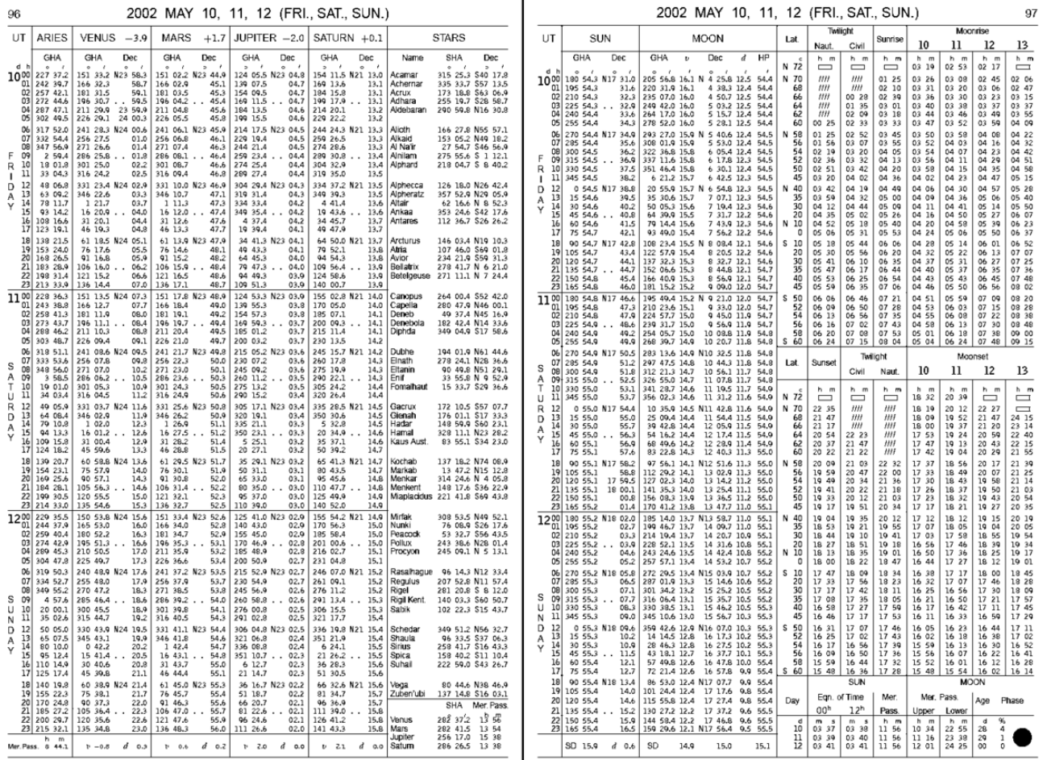

Slide 13
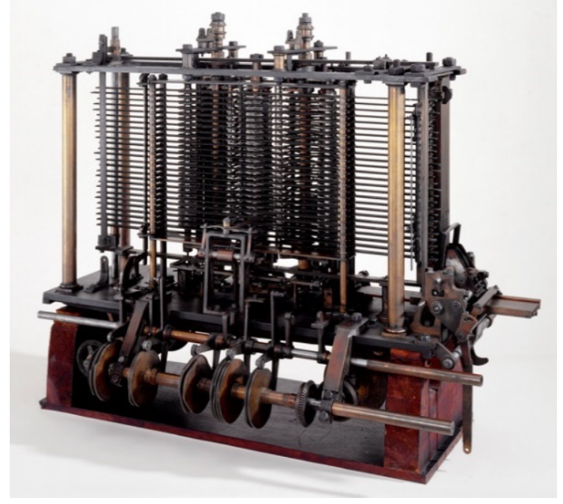
Programmable devices
Charles Babbage designed the Analytical Engine, a mechanical, programmable computer in 19th Century
It was never built in Babbage’s time due to a lack of manufacturing capabilities (ahead of his time!)
Design called for punched cards to be fed into the machine to program it to perform mathematical calculations
Output would go to a printer or punched cards

Slide 14
Programmable computers
Many others
Now, move forward to the 20th and 21st centuries
A modern computer has three basic requirements:
Must be electronic and not exclusively mechanical.
Must be digital, not analog
Uses discrete values (digits), not a continuous range of values to represent data. (i.e. digital vs mercury-based thermometer)
Must employ the stored-program concept
the device can be reprogrammed by changing the instructions stored in the memory of the computer

Slide 15
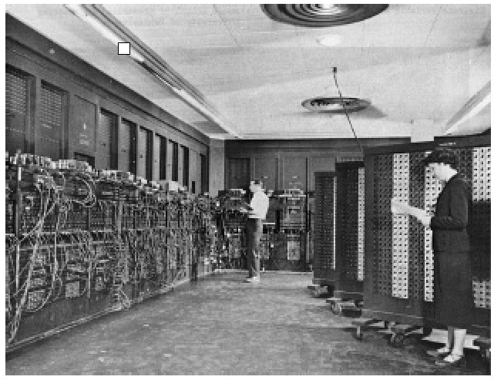
Programmable computers
ENIAC (Electronic Numerical Integrator and Computer)
Built in the 1940s
Among the first computers to employ the stored-program concept
A modern computer has four major kinds of components:
Input device(s) – examples?
Output device(s) – examples?
Memory – for data storage, both temporary & permanent
Processor – for doing computations

Slide 16
Programmable computers
Again, the stored-program concept is the idea that programs (software) along with their data are stored (saved) in the memory of a computer
Not referring to storage on hard drives, flash drives or CDs
Referring to main memory of the computer, sometimes called the RAM (random access memory)
A modern processor
reads the machine instructions stored as 1s and 0s in the main memory
executes those instructions in sequence
Key point: these instructions can be changed to easily reprogram the computer to do new tasks
A typical processor has a thousand or more different machine instructions.

Slide 17
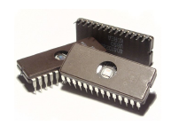
Transistors
A variety of devices have been used to represent digits and to control the operation of computing machines
In the 1940s:
Bardeen, Brattain, and Shockley invented the transistor, which is an electronic switch with no moving parts
In the 1950s and 1960s:
Kilby, Noyce, and others used transistors to develop integrated circuits
Devised a way to manufacture thousands – later, millions and billions – of transistors on a single wafer of silicon
A single chip contains:
an integrated circuit
a ceramic or plastic case
external pins to attach it to a circuit board

Slide 18
Transistors
Noyce and businessman Gordon Moore commercialized this technology by co-founding Intel Corporation in 1968
Manufacturing technologies improved in the 1950s and 1960s:
engineers were able to pack many more transistors per unit area on silicon wafers
Moore’s law: Moore observed that the number of components within an integrated circuit was doubling every 18 months.
The trend has continued pretty steadily since then.
But transistors can be only so small!
Combating miniaturization challenges:
Intel, AMD (Advanced Micro Devices) and others now make processors that feature multiple processing cores that perform calculations in parallel with each other

Slide 19
Computing systems
A computing system consists of two major parts: the hardware and the software
Some hardware elements of a computer
Screen, keyboard, mouse
Central processing unit, main memory
Hard drives and other storage units
Type of software in use
Applications software, like office productivity programs, video games, web browsers
Systems software, like operating systems, database systems

Slide 20
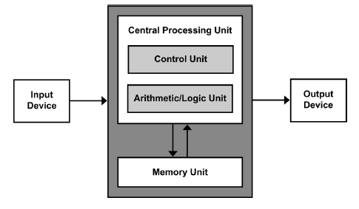
Modern computer architecture
The stored program approach used today is implemented using von Neumann architecture, named after U.S. mathematician John von Neumann
This architecture contains input devices, output devices, a processor and a memory unit
• Will now look at how they work together to form a functioning computer

Slide 21
Modern computer architecture
In modern computers (PCs), the major components in a von Neumann machine reside physically in a circuit board called the motherboard
The CPU, memory, expansion cards and other components are plugged into slots so they can be replaced
Hard drives, CD drives, and other storage devices are connected to the motherboard through cables
The central processing unit is the “brain” of the machine
its arithmetic/logic unit (ALU) performs millions or billions of calculations per second
The control unit is the main organizing force of the computer and directs the operation of the ALU

Slide 22
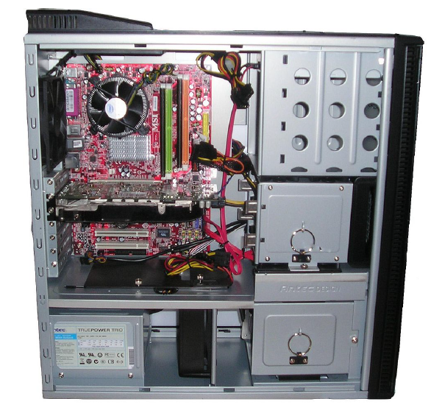
Modern computer architecture

Slide 23
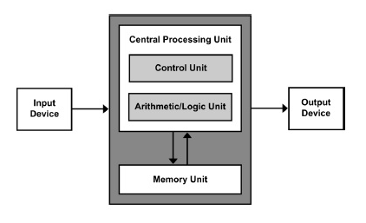
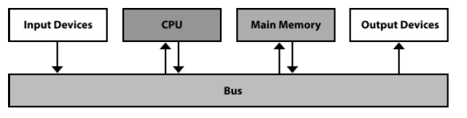
Modern computer architecture
The memory unit in this diagram refers to the main memory, not hard drives and other forms of external storage
CPU, main memory, and I/O devices communicate over a shared set of wires known as the system bus

Slide 24
The fetch-decode-execute cycle
The system bus carries electrical signals that encode machine instructions and data
The CPU fetches the instructions and data from memory as needed
The control unit decodes each instruction to figure out what it is (an addition, subtraction, whatever)
Data values (e.g., numbers to be added and their resultant sum) are stored temporarily in memory cells called registers within the CPU
The ALU executes the instruction, saving the result in the registers and main memory
This whole process is known as the fetch-decode-execute cycle
Illustration
https://chortle.ccsu.edu/java5/Notes/chap04/ch04_4.html

Slide 25
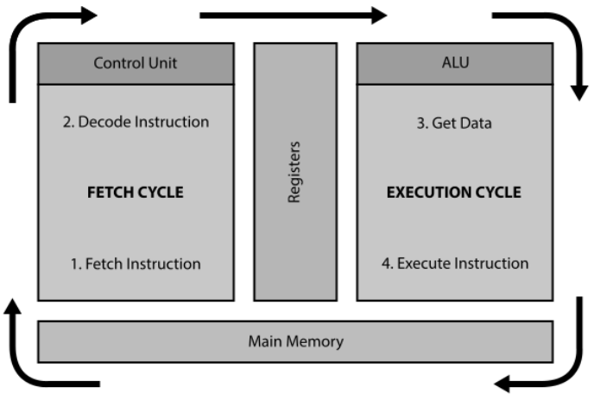
The fetch-decode-execute cycle

Slide 26
What about the software?
Software consists of instructions for the CPU to execute
CPUs “understand” something called machine language, which consists of 0s and 1s
A single instruction for a modern computer might consist of some combination of 32 or 64 0s and 1s!
Most programming now done using high-level programming languages, which consist of English and English-like words with some mathematical notation thrown in
Will look into the basics of Python, a popular, easy-to-learn, high-level programming language

Slide 27
What is computational thinking?
Computational Thinking:
How computer scientists think – how they reason and work through problems
Computer science encompasses many sub-disciplines that support the goal of solving problems:
Computer theory areas ➔ these are the heart and soul of computer science
algorithms
data structures
Computer systems areas
hardware design
operating systems
networks
Computer software and applications
software engineering
programming languages
Databases
Simulation
artificial intelligence
computer graphics
A major goal of this course is to help you develop your computational thinking and problem solving skills

Slide 28
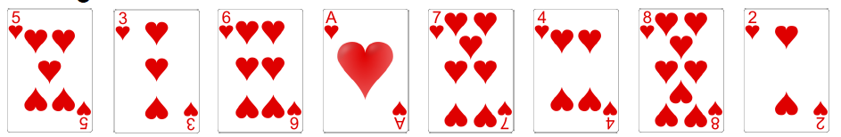
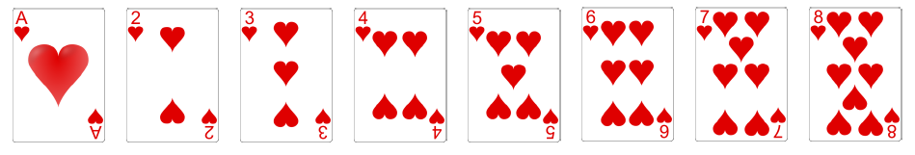
A classical problem: Sorting data
Suppose we have a deck of cards we want to put in order
Sorting: important problem – arises frequently in computer science
Example: Use the Ace thru 8 of Hearts
Given:
Want the following:

Slide 29
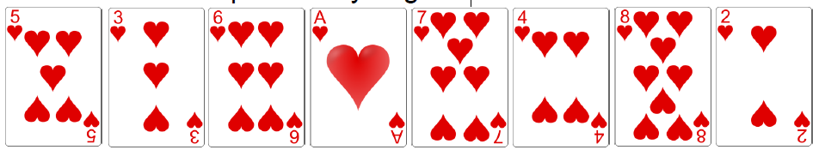
A classical problem: Sorting data
You want to explain to a young child how to put the cards in order
What steps would you give?

Slide 30
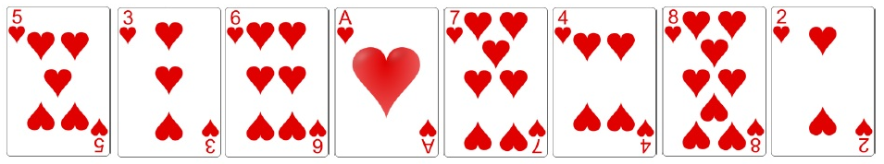
A classical problem: Sorting data
One sorting technique is called selection sort
It repeatedly searches for and swaps cards in the list

Slide 31
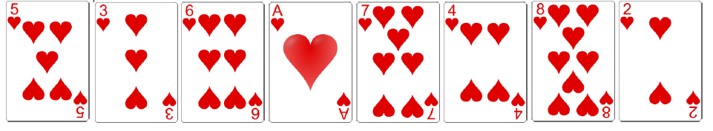
Selection sort
First, find the smallest item and exchange it with the card in the first position

Slide 32
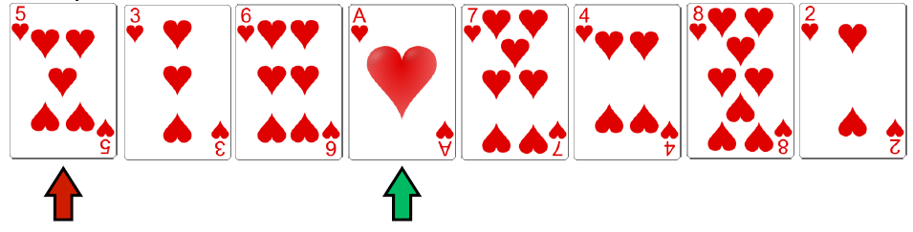
Selection sort
Select the smallest item and exchange it with the card in the first position

Slide 33
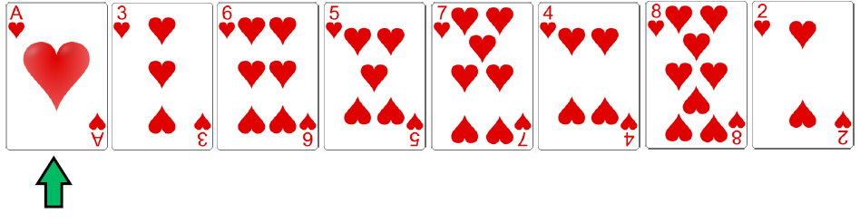
Selection sort
Collection after the exchange

Slide 34
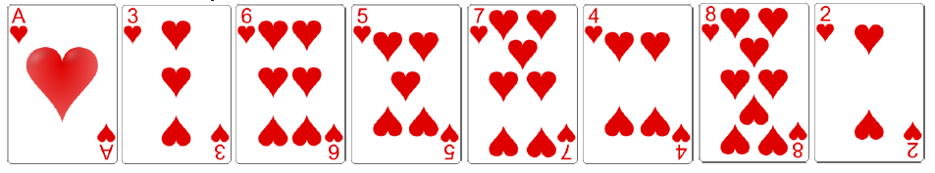
Selection sort
Next, select the second-smallest item and exchange it with the card in the second position

Slide 35
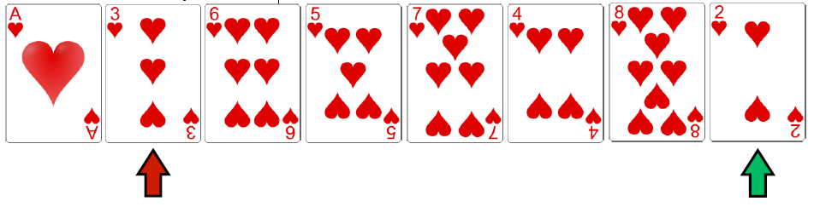
Selection sort
Select the second-smallest item and exchange it with the card in the second position

Slide 36
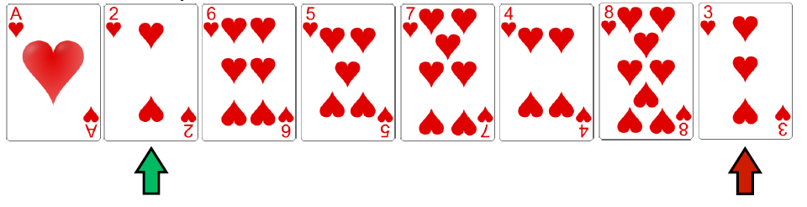
Selection sort
Collection after the exchange

Slide 37
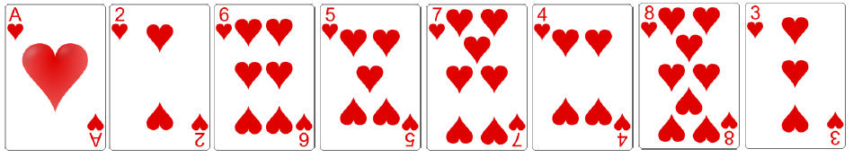
Selection sort
Continue in this fashion, selecting the third-smallest, fourth-smallest, etc., until the list is sorted

Slide 38
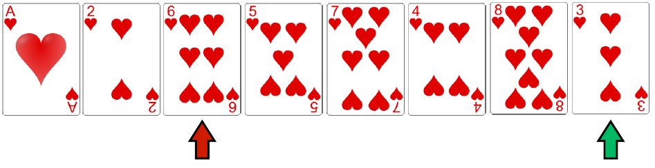
Selection sort
Continue in this fashion, selecting the third-smallest, fourth-smallest, etc., until the list is sorted

Slide 39
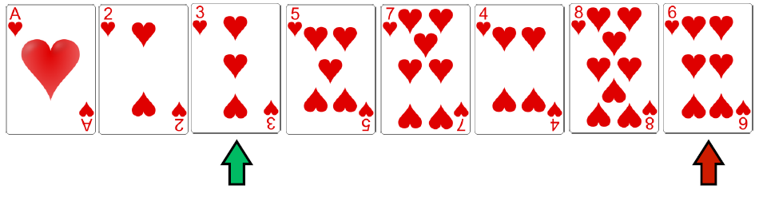
Selection sort
Continue in this fashion, selecting the third-smallest, fourth-smallest, etc., until the list is sorted

Slide 40
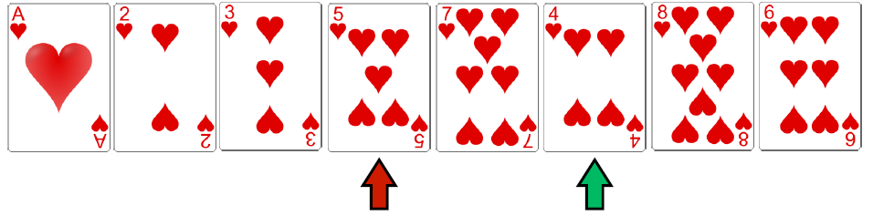
Selection sort
Continue in this fashion, selecting the third-smallest, fourth-smallest, etc., until the list is sorted

Slide 41
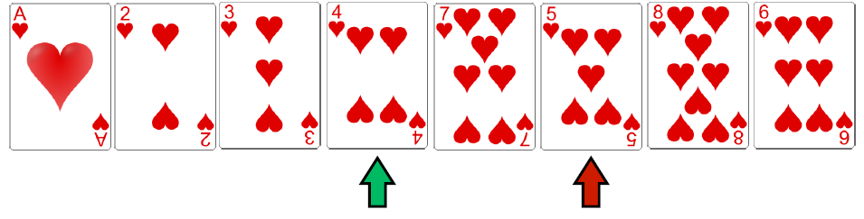
Selection sort
Continue in this fashion, selecting the third-smallest, fourth-smallest, etc., until the list is sorted

Slide 42
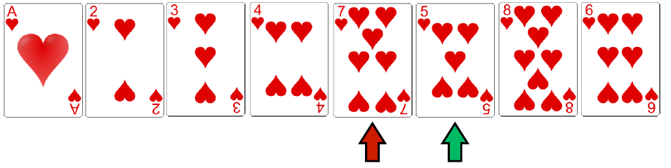
Selection sort
Continue in this fashion, selecting the third-smallest, fourth-smallest, etc., until the list is sorted

Slide 43
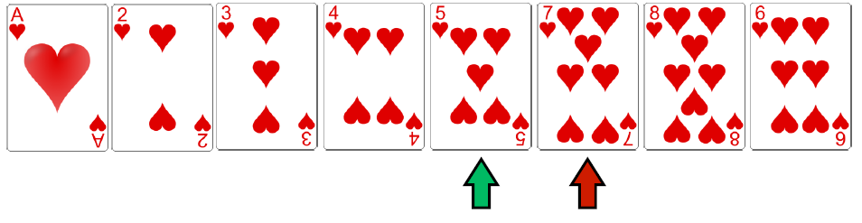
Selection sort
Continue in this fashion, selecting the third-smallest, fourth-smallest, etc., until the list is sorted

Slide 44
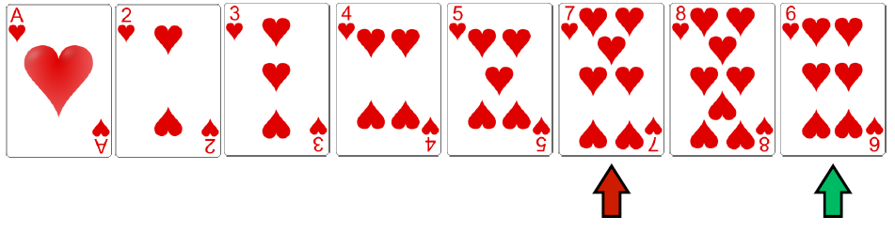
Selection sort
Continue in this fashion, selecting the third-smallest, fourth-smallest, etc., until the list is sorted

Slide 45
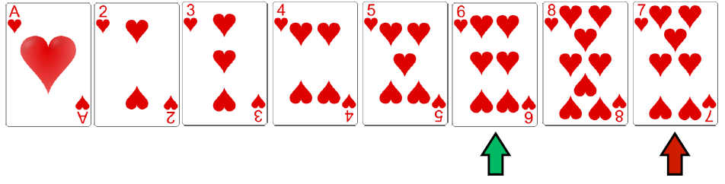
Selection sort
Continue in this fashion, selecting the third-smallest, fourth-smallest, etc., until the list is sorted

Slide 46
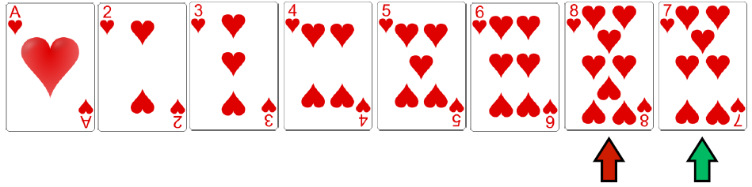
Selection sort
Continue in this fashion, selecting the third-smallest, fourth-smallest, etc., until the list is sorted

Slide 47
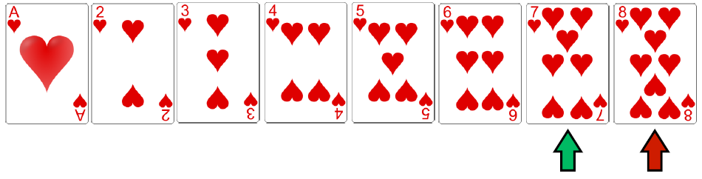
Selection sort
Continue in this fashion, selecting the third-smallest, fourth-smallest, etc., until the list is sorted

Slide 48
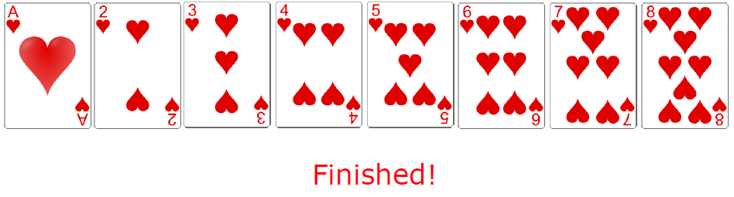
Selection sort
Continue in this fashion, selecting the third-smallest, fourth-smallest, etc., until the list is sorted

Slide 49
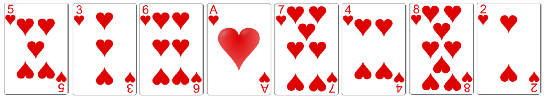
A classical problem: sorting data (2)
Another sorting technique is insertion sort
It repeatedly inserts the “next” card into its correct spot

Slide 50
Insertion sort
We begin by leaving the first card (#5) where it is

Slide 51
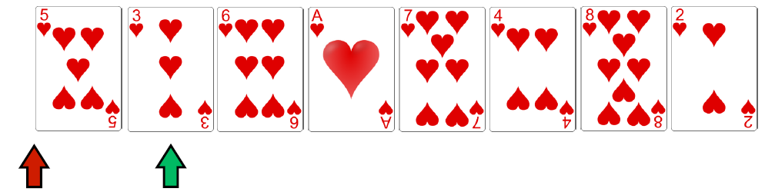
Insertion sort
The second card (#3) is smaller than the first card
Insert it in front of the first card

Slide 52
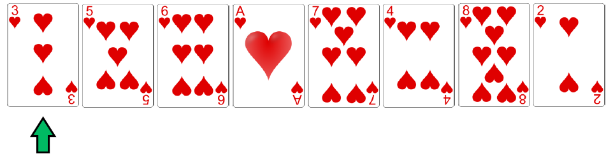
Insertion sort
The second card (#3) is smaller than the first card
Insert it in front of the first card

Slide 53
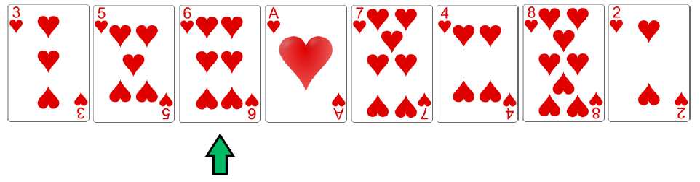
Insertion sort
The third card (#6) is larger than the first two cards
So, we don’t need to move it

Slide 54
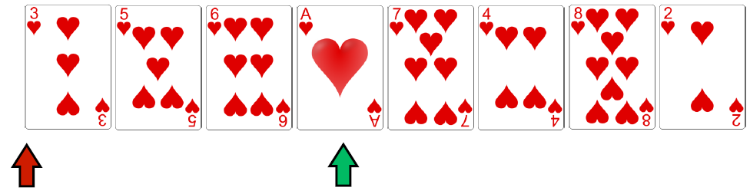
Insertion sort
The fourth card (#1) is smaller than the first three cards
Insert it in front of the first card, shifting the others

Slide 55
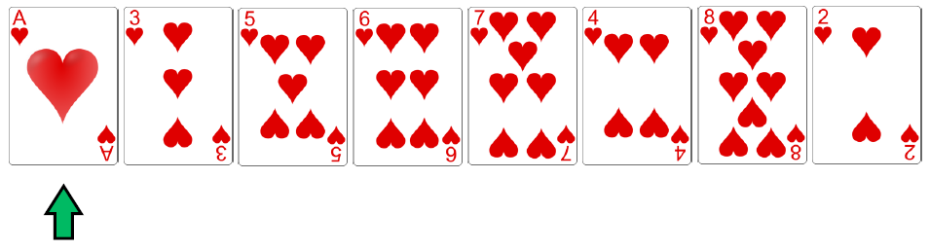
Insertion sort
The fourth card (#1) is smaller than the first three cards
Insert it in front of the first card, shifting the others

Slide 56
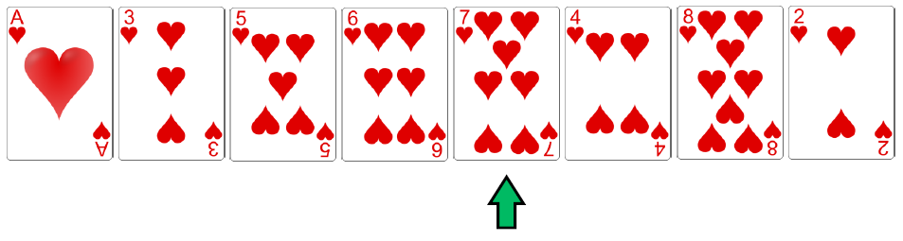
Insertion sort
The fifth card (#7) is larger than the first four cards
So, we don’t need to move it

Slide 57
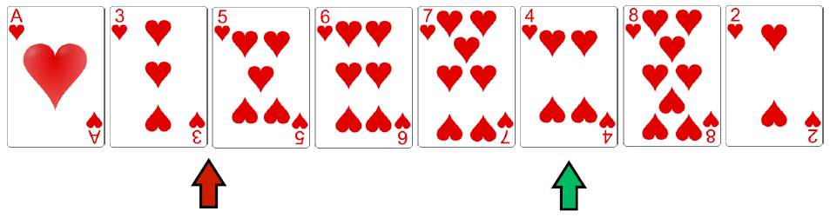
Insertion sort
The sixth card (#4) should be inserted in between the second (#3) and third (#5) cards

Slide 58
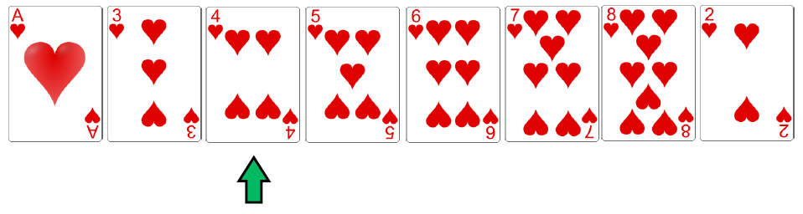
Insertion sort
The sixth card (#4) should be inserted in between the second (#3) and third (#5) cards

Slide 59
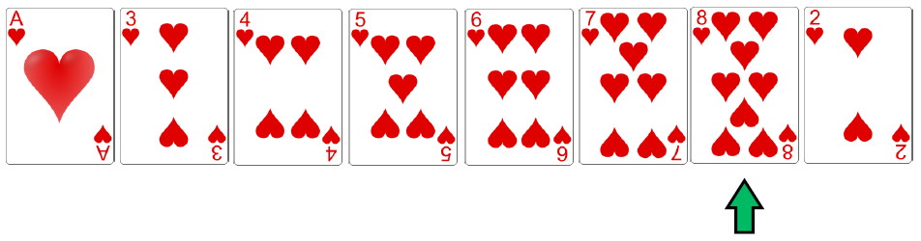
Insertion sort
. The seventh card (#8) is larger than the first six cards
. So, we don’t need to move it

Slide 60
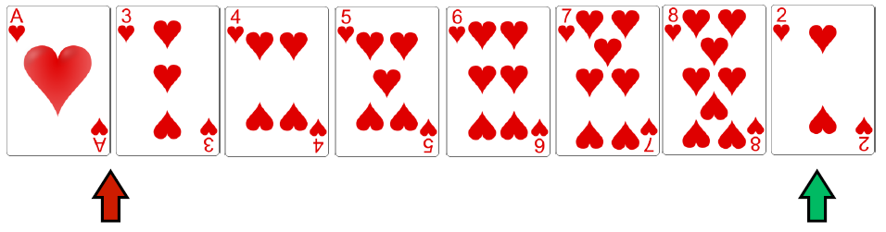
Insertion sort
The eighth card (#2) should be inserted in between the first (#1) and second (#3) cards

Slide 61
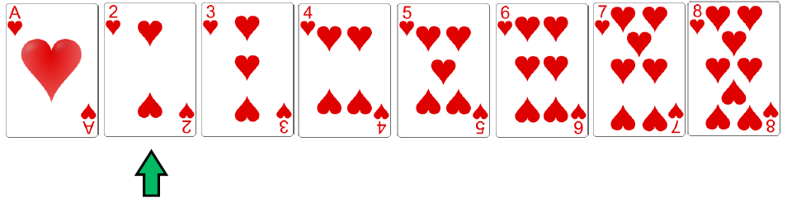
Insertion sort
The eighth card (#2) should be inserted in between the first (#1) and second (#3) cards

Slide 62
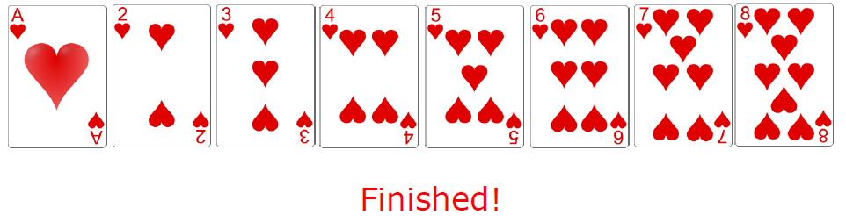
Insertion sort
The eighth card (#2) should be inserted in between the first (#1) and second (#3) cards

Slide 63
Sorting algorithms
We have just confirmed there can be different ways to solve the same computational problem
➔ can derive many different algorithms for solving the sorting problem
Algorithm:
A set of concrete steps
Steps solve a problem or accomplish some task
Solve in a finite amount of time
The earliest algorithm known as Euclid’s algorithm dates from 300 BC and used to find the Lowest Common Denominator of two numbers.
The Selection Sort and Insertion Sort algorithms are only two ways of sorting a list of values
New problem: Wish to sort a list of student records by their GPAs.
Would both of these algorithms work?
Yes! A hallmark of a good algorithm is that it is general ➔ can solve a wide variety of similar problems

Slide 64
Limits of Computation
What computer can do? | What computer cannot do?
Send email to a person if email address is known. | Find email of a person we met at a coffee shop.
Calculate difference investment options based on historical data. | Choose a perfect investment or predict success and future of companies.
Find information about colleges offering computer science course. | Make a perfect decision on the best school to attend.
Solve well defined problems. | Solve ambiguous problems.

Slide 65
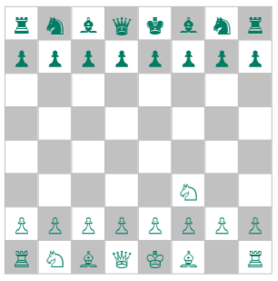
Unsolvable Problems
If a computer tries to analyze every possible sequence of moves in response to this opening in a game of chess, it will have to consider over 1043 different games.
Computer solving one trillion combinations per second will compute the perfect game of chess if we are patient enough to wait 10²¹ years, so it is only unsolvable in a practical sense.

Slide 66
To sum up…
Computer science is the discipline of how to solve problems using computers
We strive for efficient, general solutions that will work on a wide variety of problem types
Although computer science has existed as a field for about 70 years, its roots in mathematics and computation go back thousands of years!
CS is a very peculiar field
it relies partly on old mathematical ideas
it advances in development of new techniques at an extraordinary pace
The semester you will be exposed to many of the modern topics in CS and also to some of the older mathematical content that is still very relevant today

Slide 67
Questions?

